Slide 1

Jet
Jonathan Enav
Efrat Isack
Tal Brender

Slide 2
EDA
decision made
feature analysis
Validation
Modeling

Slide 3


Slide 4
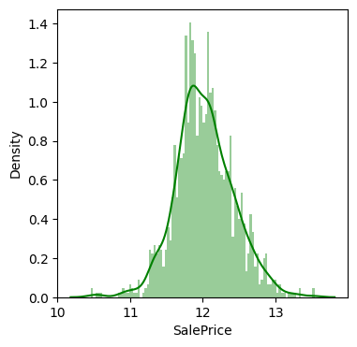
EDA: Log House Price Distribution
Log normal distribution
In range 10.5-13.5
Mean about 12

Slide 5
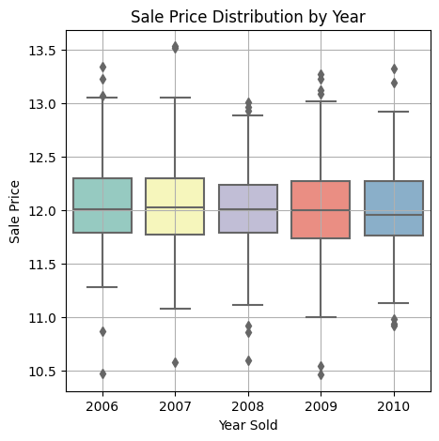
EDA sale price Vs year
Sale price does not depend on year sold

Slide 6
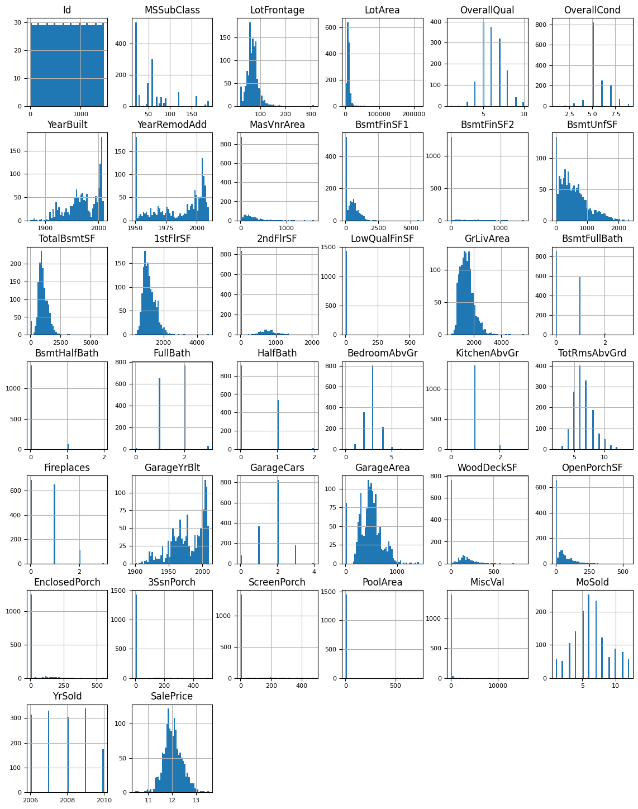
EDA: numeric features
Some of the numeric features are categorical, like MoSold.
Some are finite, some are Gaussian, and some are skewed
Some of these features are discrete while some are continuous.
The meaning of the features varies according to context, such as years or quality grade, and some are just numeric measurements like sizes. Some of these features are mostly single variables

Slide 7
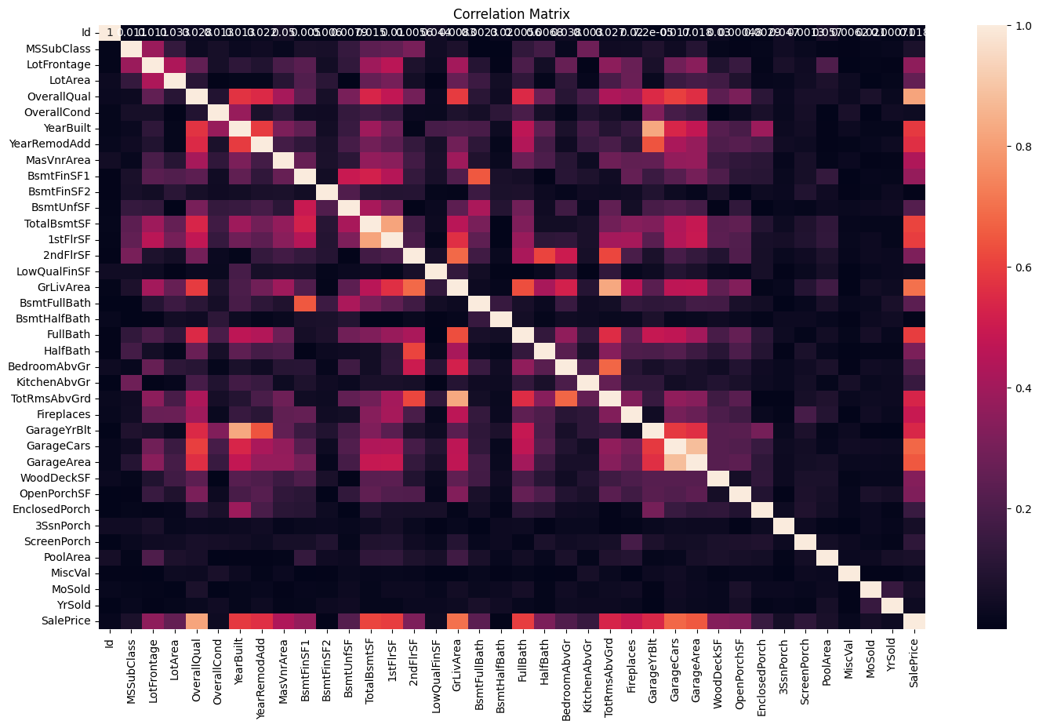
EDA correlation matrix
Some of the features are highly correlated with each other; for example, the year built, and the garage year built are 0.85 correlated. This implies that one of them might be less important for the prediction once we have the second.

Slide 8
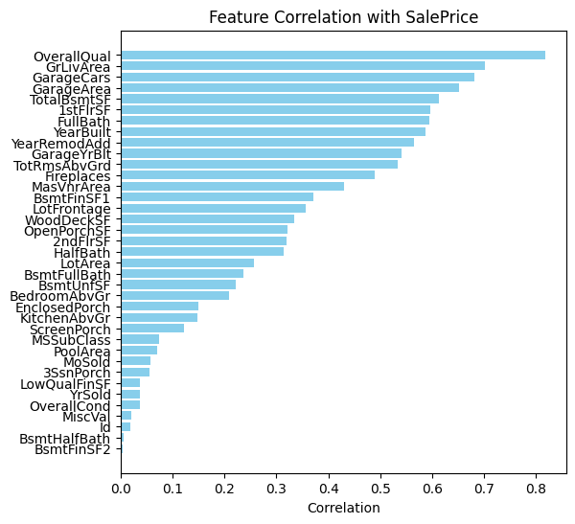
EDA feature correlation with target
most correlated features
OverallQual 0.817184
GrLivArea 0.700927
GarageCars 0.680625
GarageArea 0.650888
TotalBsmtSF 0.612134

Slide 9
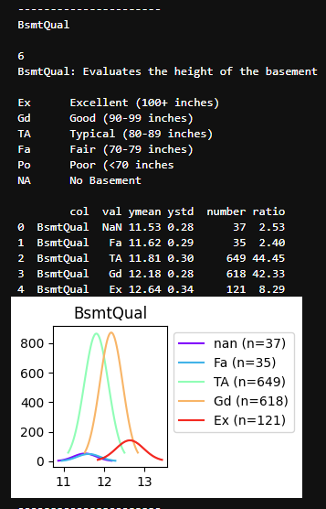
EDA
For each categoric feature, check the mean and std of targets in this categoric
For example, we can see that basements quality might be a good indicator for price.
This will help us to encode categoric features

Slide 10
EDA: NA
features with the highest number of missing values in %
PoolQC 99.520548
MiscFeature 96.301370
Alley 93.767123
Fence 80.753425
MasVnrType 59.726027
FireplaceQu 47.260274

Slide 11
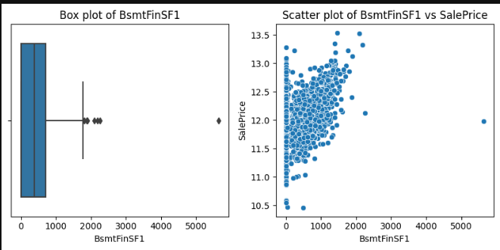
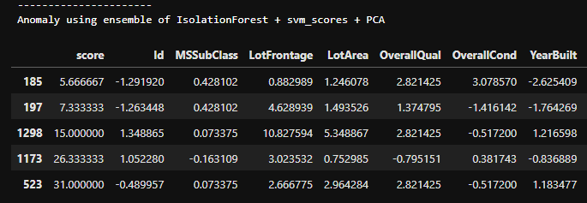
EDA: Anomaly detection
Models to find anomaly detection detect several interesting points.
We test the effect of modeling with/without those points
Removing the points improves the train results but degrade the test results so we chose to keep them

Slide 12
EDA manual categoric feature importance
Using the difference between groups and the number of samples in each category, we manually characterizes the feature importance
Not: [Street, LandContour, Utilities, LotConfig, LandSlope, Condition2, RoofMatl, ExterCond, Heating, Functional, GarageQual, GarageCond, PavedDrive, PoolQC, Fence, MiscFeature],
Low: [Alley, Condition1, BsmtCond, BsmtFinType2, CentralAir, Electrical],
Med: [MSZoning, BldgType, HouseStyle, RoofStyle, Exterior1st, Exterior2nd, BsmtExposure, BsmtFinType1, SaleType, SaleCondition],
High: [LotShape, Neighborhood, MasVnrType, ExterQual, Foundation, BsmtQual, HeatingQC, KitchenQual, FireplaceQu, GarageType, GarageFinish]

Slide 13


Slide 14
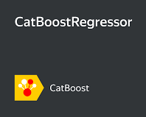
Base line
Imputing NA
Split test - train
Cat boost that handles all categoric with default params
RMSE: 0.132043

Slide 15
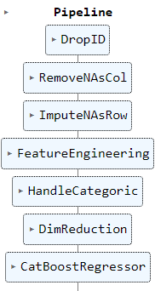
Final Pipeline

Slide 16
steps
Set the target to be log : improve results since the grade is based on RMSE of log price diff
Remove ID
Remove columns with more than 15% Nas
Impute rows
When no Garage impute all Group 'GarageType', 'GarageYrBlt', 'GarageFinish', 'GarageQual', 'GarageCond')
When no Bsmt impute all Group ('BsmtQual', 'BsmtCond', 'BsmtExposure', 'BsmtFinType1', 'BsmtFinType2’)
Impute by mean, median or zero by context
Impute 'GarageYrBlt’ according to 'YearBuilt’
Try more sophisticated imputation but it was not effective

Slide 17
steps
Feature engineering
Add features to sum up similar columns, for examples:
X['TotalSF']=X['TotalBsmtSF'] + X['1stFlrSF'] + X['2ndFlrSF’]
X['Total_sqr_footage'] = (X['BsmtFinSF1'] + X['BsmtFinSF2'] + X['1stFlrSF'] + X['2ndFlrSF’])
X['haspool'] = X['PoolArea'].apply(lambda x: 1 if x > 0 else 0)

Slide 18
steps
Encode categorical features to numeric according to sorted price mean of the category
To avoid over-fitting group together categories with small amount of samples
Dimentionality reduction: remove features with dimentarget_correlation_abs<=0.01

Slide 19

steps
Model Cat boost with params:
Hyper_params =
'learning_rate': 0.05
'depth’: 5
'subsample': 0.23,
'colsample_bylevel': 0.9,
'min_data_in_leaf’: 4,
'n_estimators’: 751

Slide 20
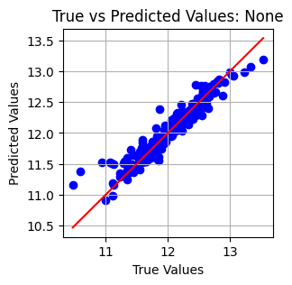
validation
Performing cv with Kfolds=10 yield the following results:
LogRMS with CV CatTransll Hyper_params : 0.1146 (0.0194)
This is some improvement relative to the baseline 0.13 (Was it worth the trouble??)
Error analysis: a few samples with high or low prices, the model under-estimate high prices and over-estimate low process.

Slide 21
Post Pipe Fix
We manually fix the high prices, under-estimation, side:
q2 = output['SalePrice'].quantile(0.99)
output['SalePrice'] = output['SalePrice'].apply(lambda x: x if x < q2 else x*1.14)

Slide 22

Failing attempts among many others
Transforming categorical data into ordinal versus using mean encoding gives similar results.
Imputing missing values by the average price in the neighborhood.
Combining Gradient Boosting with Decision Trees.
Anomaly detection and removal.
Performing K-means clustering to identify different groups within the data.
Convert 'MoSold' and 'MSSubClass' to categorical data types.
More Hyperparameter optimization.
More Feature engineering
Dropping features with either 90% or more, or 15% or less missing values does not affect the results.
PCA, why???
Manually Reducing features that is not correlated to the target
Manually fix ['MSZoning']=='C (all)’ – total failed
Linear, lasso, ridge, XGboost
Stacking, Blending

Slide 23
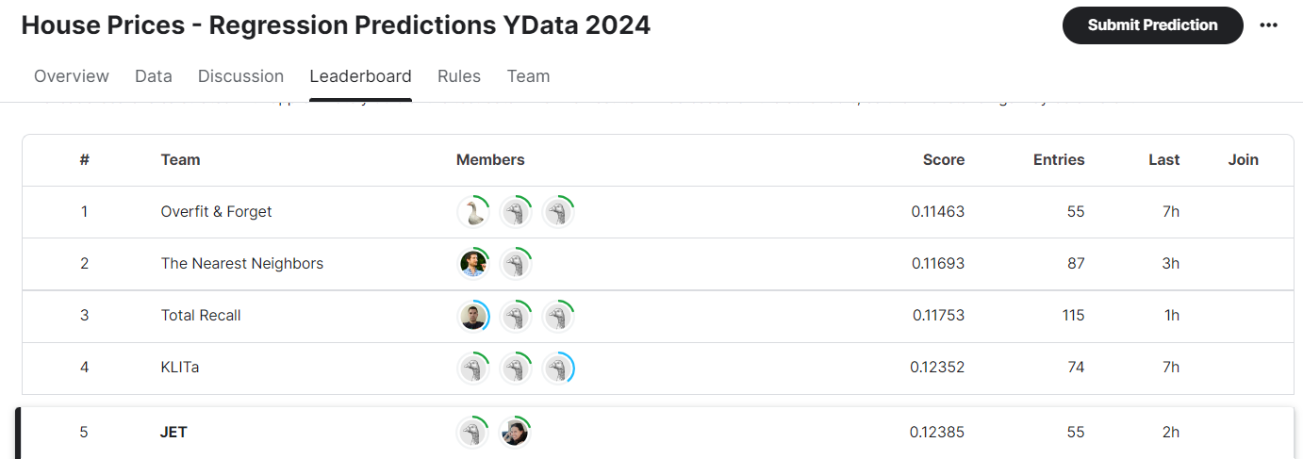
Score: 5th place

Slide 24


